Slide 1
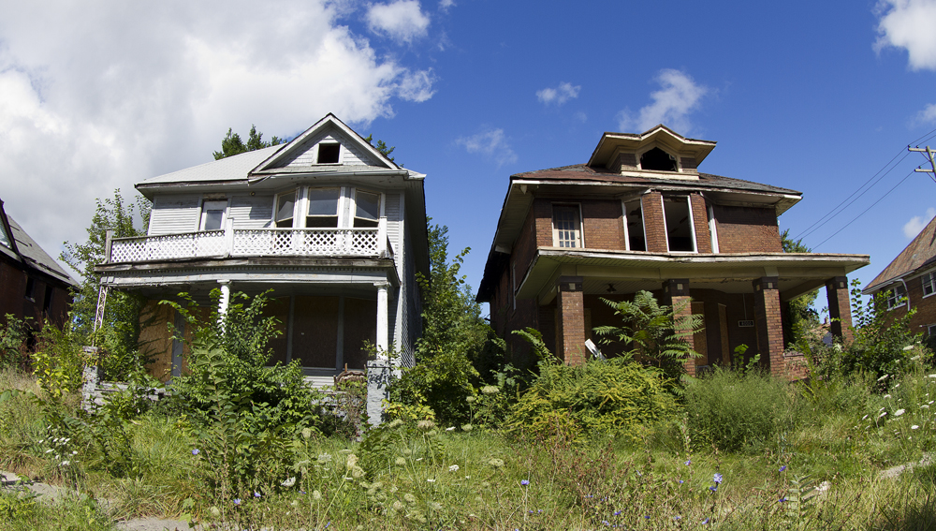
Chapter 25 Section 3 – 1980s Social Issues

Slide 2
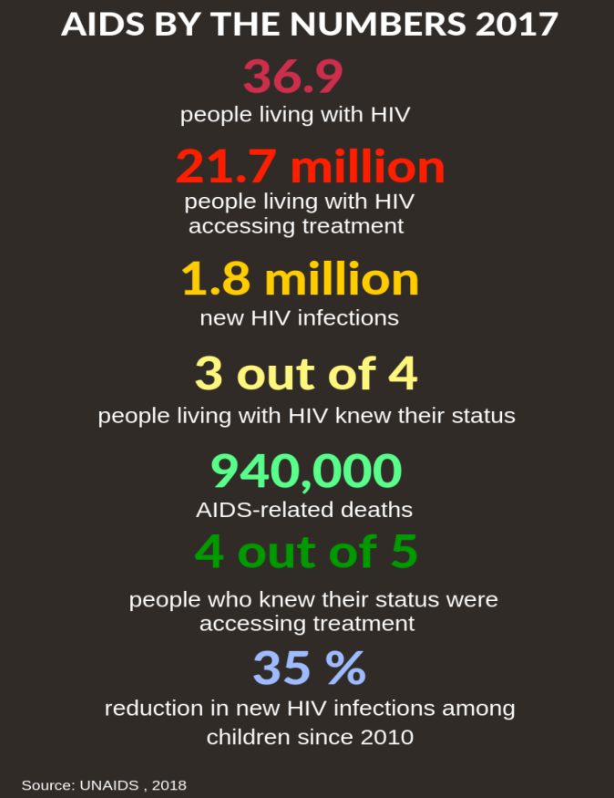
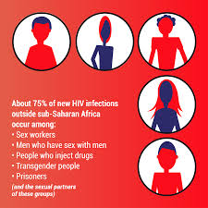
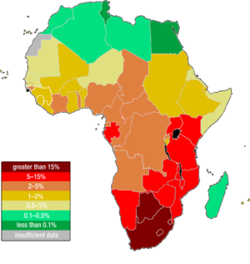
AIDS – Acquired Immune Deficiency Syndrome
Virus that destroys immune system
Transmitted through bodily fluids (blood, sex, sharing needles)
Makes body prone to a variety of health problems
Spread rapidly in 1980s
First common in gay community, eventually everywhere
Awareness and prevention campaigns started to slow it down
Still no cure (drugs used to slow it down)

Slide 3
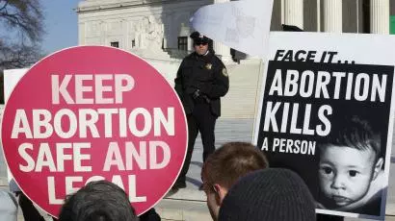
Abortion
Still legal (Roe v. Wade)
Can terminate a pregnancy during 1st 3 months
Still controversial
Pro – Life = People that oppose most abortions
Human life begins at conception “Babies can’t speak for themselves”
Pro – Choice = People that support most abortions
Women should be able to control their own bodies
If abortions become illegal, more women will die from “illegal” abortions
Many States start making it more difficult to have an abortion during 2nd 3 months of pregnancy (“Conservatism”)

Slide 4
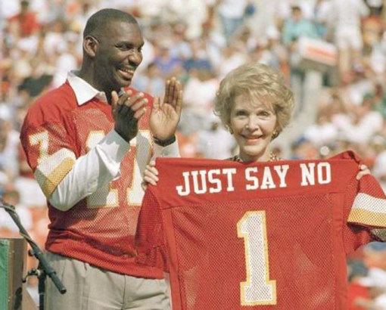
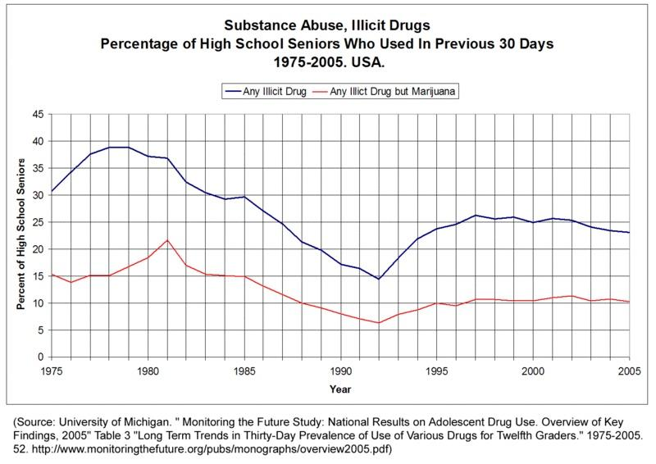
Illegal Drugs
Use became way more common
Public started to become openly concerned
Solutions offered
Legalizing and taxing them (didn’t happen)
More treatment facilities (for addicts)
Solution used by the govt.
“Just Say No” campaigns
In the media, in schools, etc…
Drug use declined some throughout the decade

Slide 5
Education
A Nation At Risk
Gov. Report that said U.S. educational system was behind most advanced foreign countries
What to do?
More Homework
Longer School Days
Longer School Years
Higher Pay for Teachers
More Required Core Classes
Were recommendations followed?
Mostly NO
Why?
Costs tax $
Parents and Students resist

Slide 6
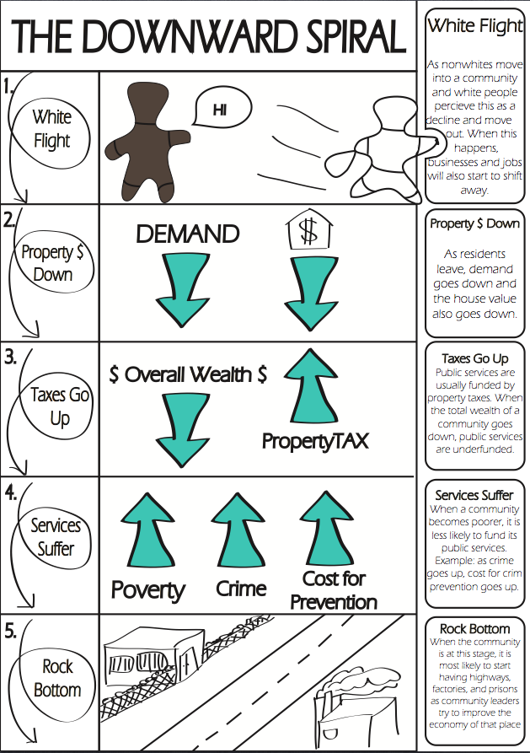
Deteriorating Cities
Mainly due to White Flight (remember!)
Results
High Unemployment
Crumbling Public Buildings
No tax $ for Public Services
Trash collection, Maintenance, etc…
Higher rates of crime and drug abuse

Slide 7
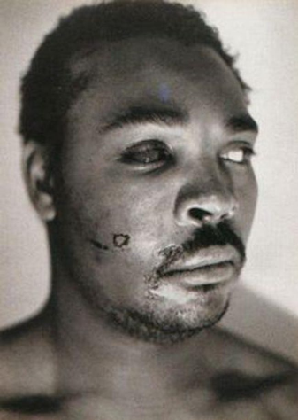
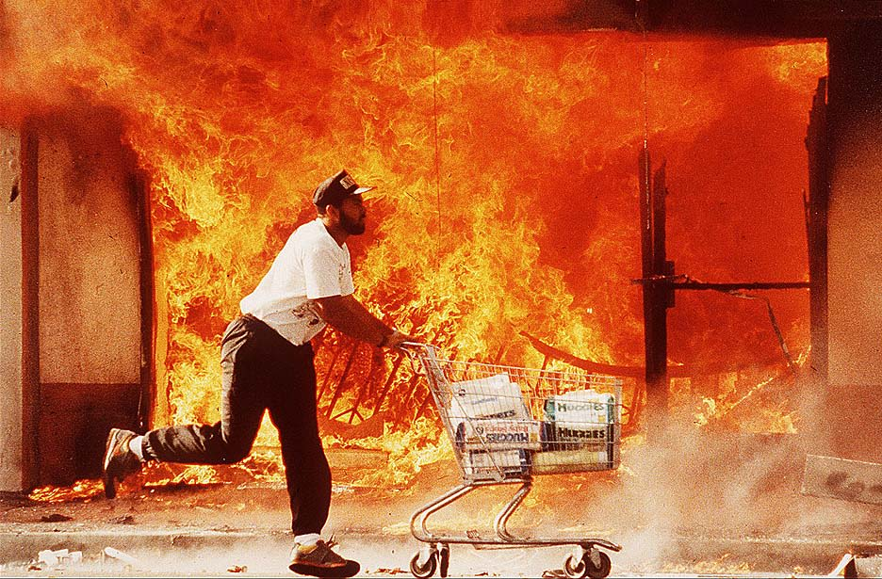
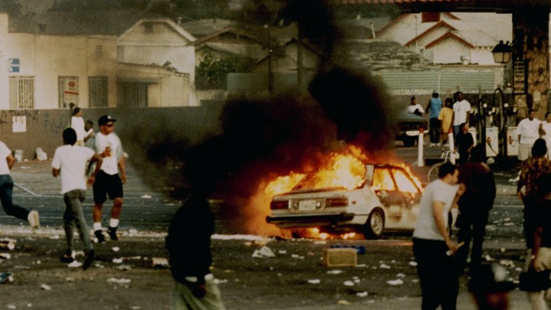
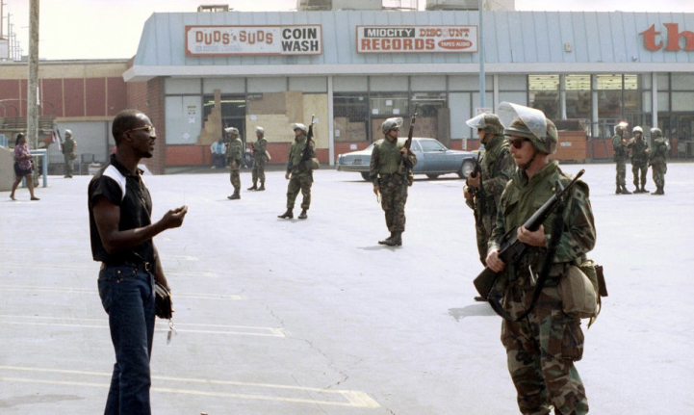
Los Angeles Riots
Began because of the Rodney King incident
4 white police officers were on video beating a black motorists
found not guilty of police brutality at trial
Fires, Looting, Beatings, and Gunfire occur over next 5 days
63 people die
Over 2,000 injured
12,000 arrested
Over 1 billion $ in property damages
Military called in to end riots
Result = Police department changes around U.S

Slide 8
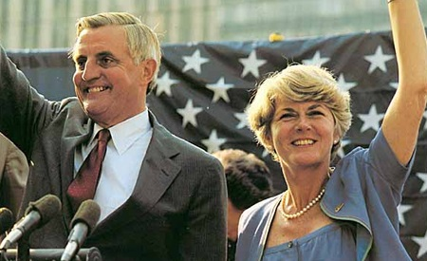
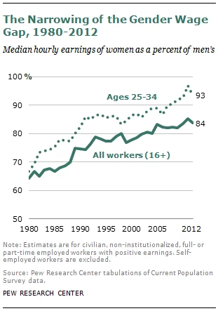
Women’s Issues
More politically involved in ‘80s and ‘90s than ever before
1st female VP nominee (Ferraro 1984)
Substantially higher involvement in Congress and Cabinet
Still not equal representation as men
Salary becoming more equal
Not totally equal (75 cents for every $1 men make)
Higher poverty rates for female heads of households
Less alimony and child support rewarded than past
Workplaces begin accommodating women
Maternity leaves, child care, flexible schedules, etc…
The govt. cuts funding for these programs though

Slide 9
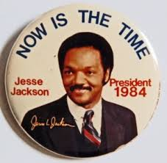
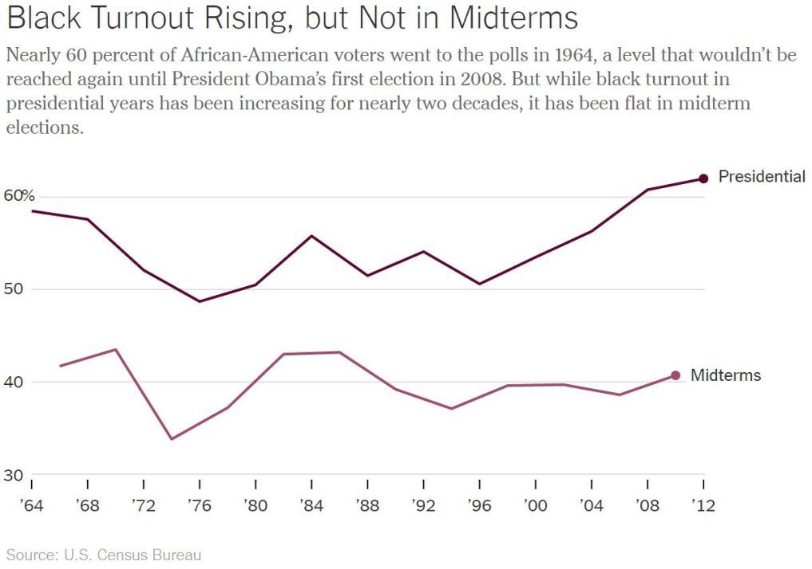
African – American Issues
More politically involved in ‘80s and ‘90s than ever before
Higher voter turnout in elections
Mayors of major cities and member of Congress
1st Black Governor = L. Douglas Wilder (Virginia 1990)
1st serious Black Pres. Candidate = Jesse Jackson (1984)
Decrease in affirmative action programs
Sup. Court rules many as reverse discrimination

Slide 10
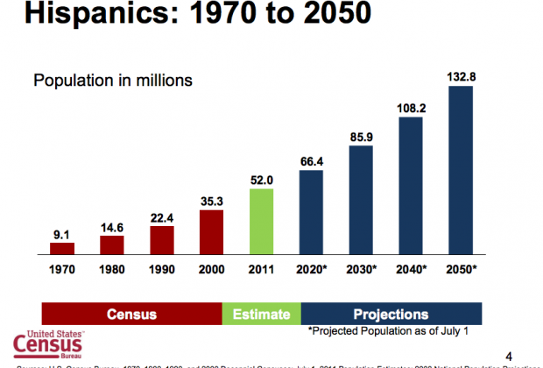
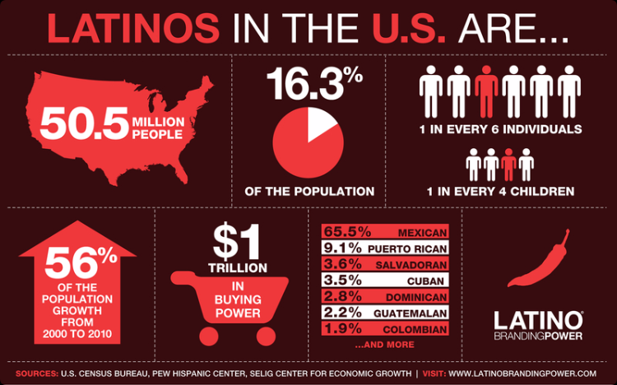
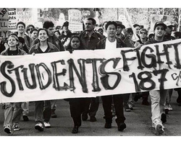
Latino Issues
Fastest growing minority in the U.S. during the ‘80s and ‘90s
Most from Mexico
Most settled in Southwestern U.S.
More politically involved than ever
Higher voter turnout in elections
A few governors and Cabinet members
Important political issue = Bilingual Education
Wanted to keep their language and heritage
Some people in U.S. oppose this
Slower to assimilate into U.S. society
Believed it would divide the country

Slide 11
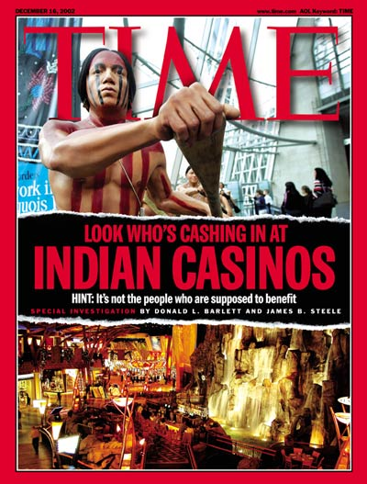
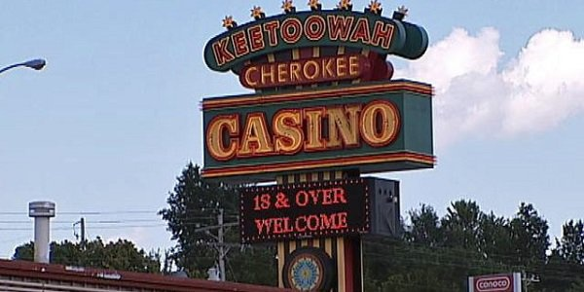
Native American Issues
Govt. cuts funding dramatically in ‘80s and ‘90s
Continues to be true today
Need $ for reservation programs
Begin opening casinos around the country
Helps some, but don’t solve all problems
A lot of $$$ doesn’t go where its supposed to

Slide 12
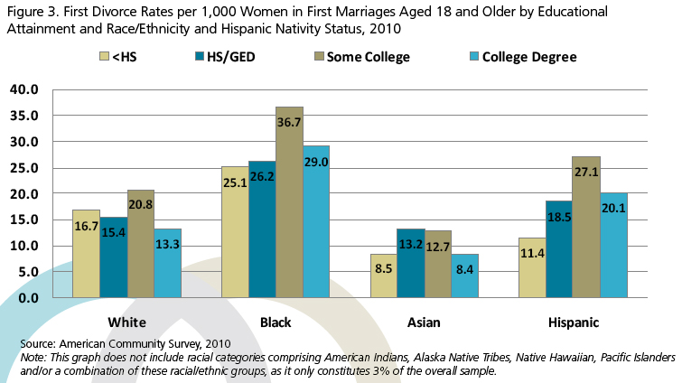
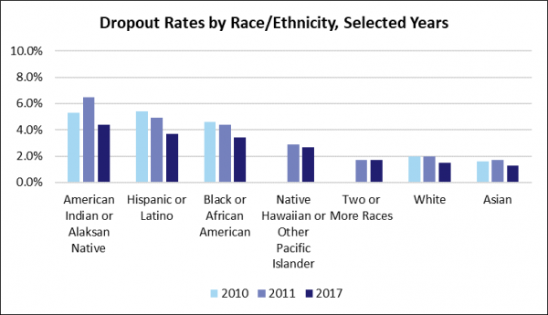
Asian American Issues
2nd Fastest growing minority during the ‘80s and ‘90s
Low crime rate, Low dropout rate, Low divorce rate
Compared to other races

Slide 13
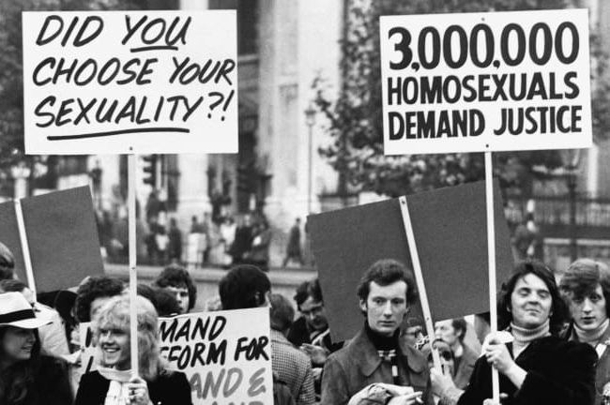
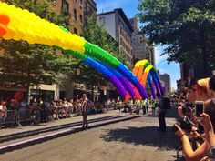
Gay Issues
Community fights openly to be treated equally in ‘80s and ‘90s
Mostly successful by 2000
State and National Laws vary

