Slide 1
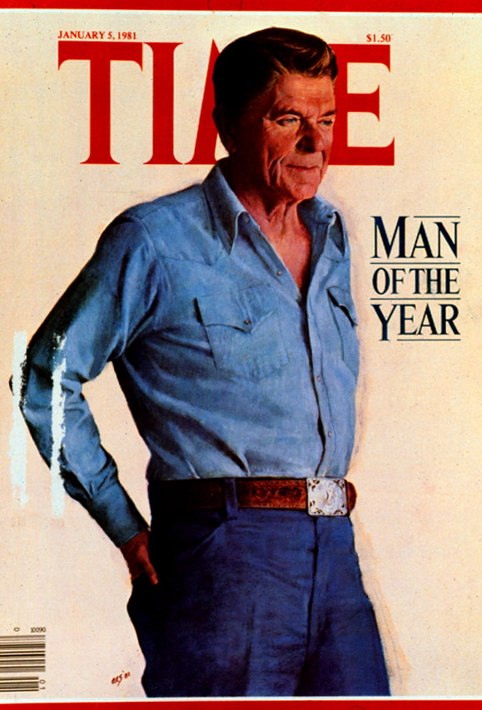
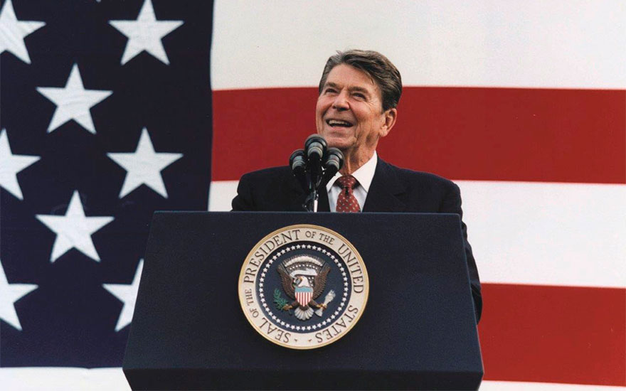
Chapter 25 Section 2 Notes The Reagan Presidency

Slide 2
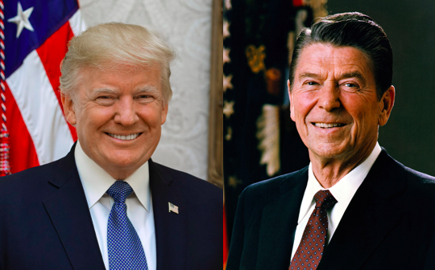
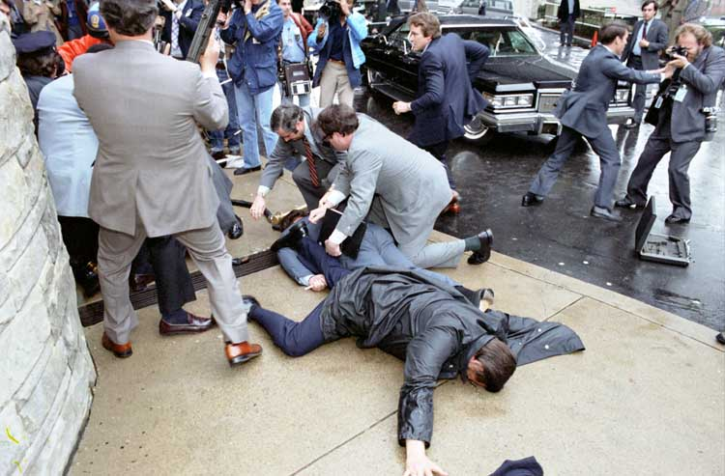
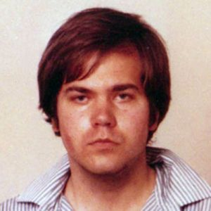
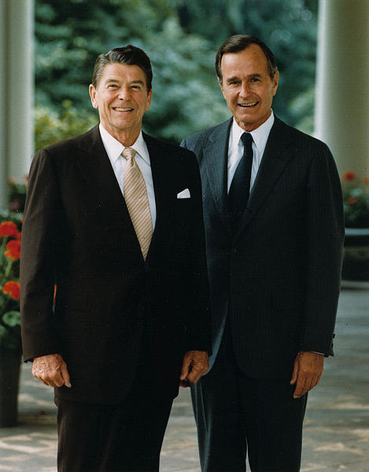
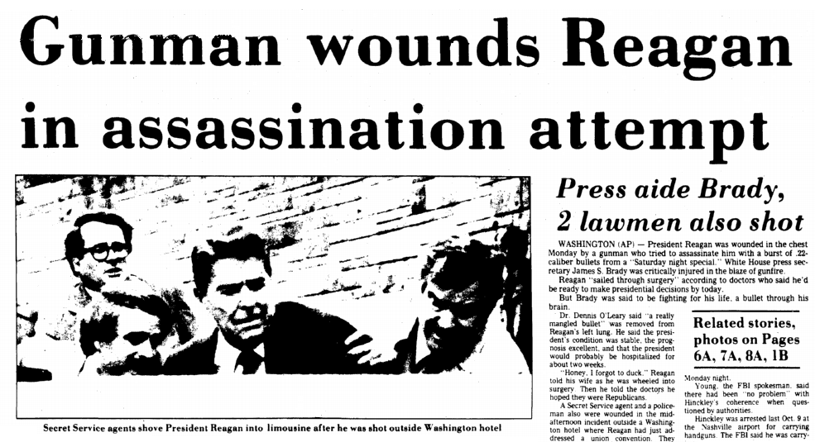
General Info
oldest President to ever be elected at the time (near 70)
Trump a little older
in office 2 full terms (still oldest ever… near 78 when done)
almost assassinated in the beginning
shot by John Hinckley Jr. after 1 year
extremely popular
likeable and charming personality
George Bush Sr. was his Vice Pres.

Slide 3
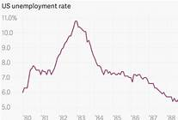
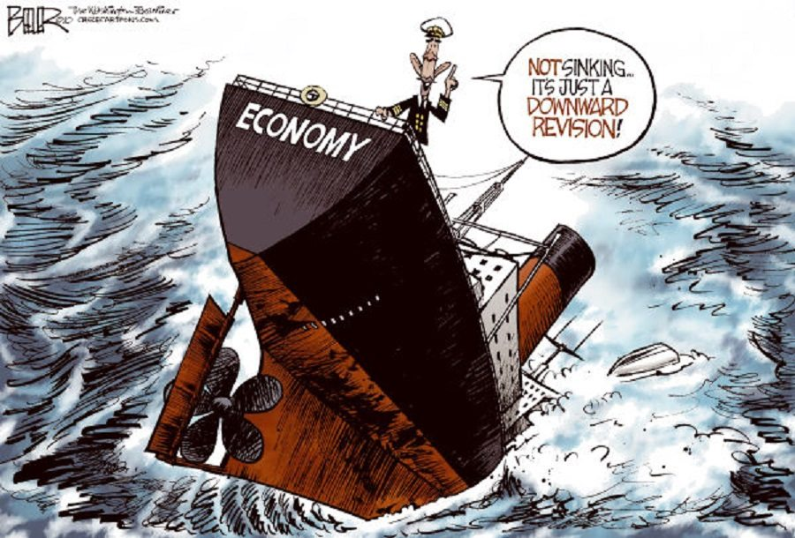
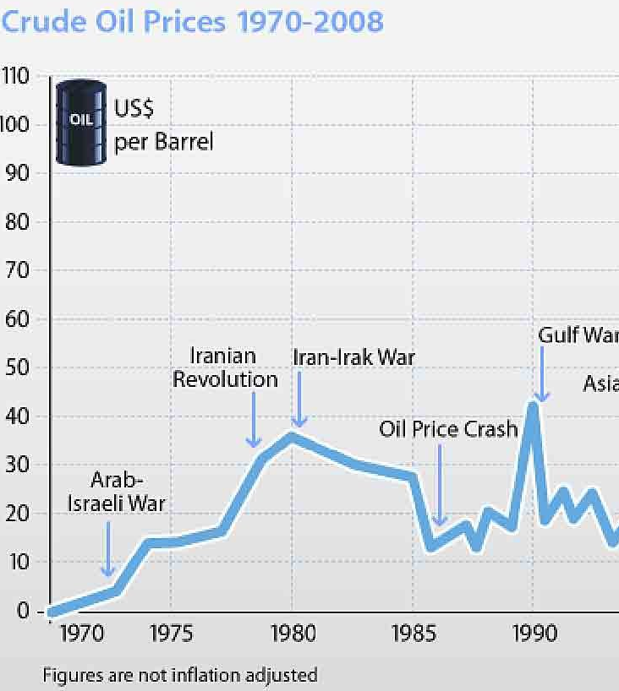
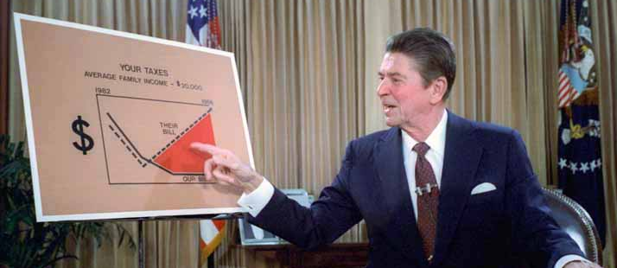
The Economy Under Reagan
Recession during his 1st 2 years in office
A lot of the same reasons as when Carter was Pres.
High taxes, High energy costs, Growing unemployment

Slide 4
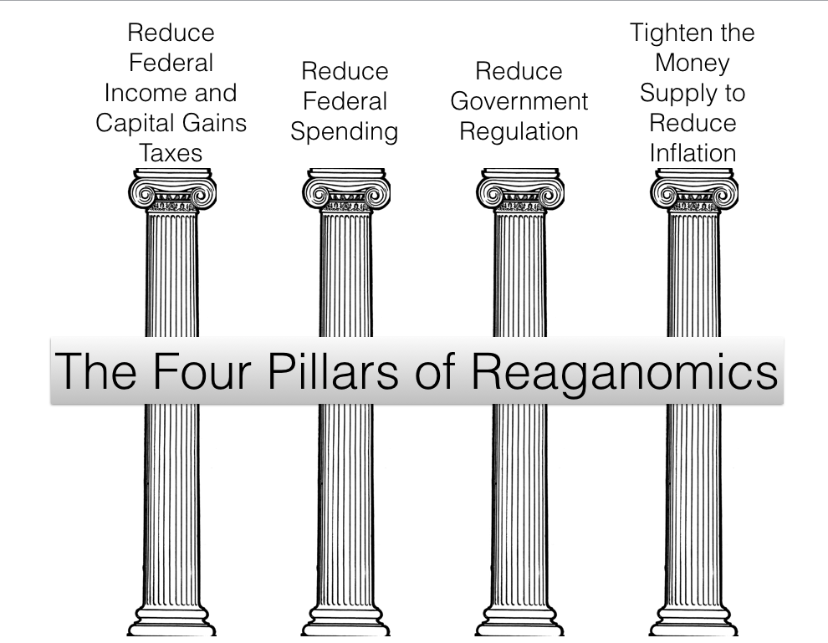
Reaganomics!
Reagan’s plan to fix the economy
4 major policies it depended on

Slide 5
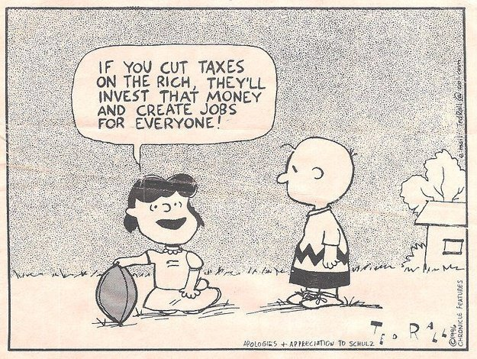
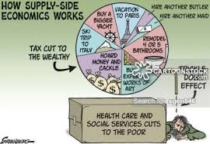
1. Lower Taxes For Everyone
About a 25% Reduction to EVERYONE (helps rich the most!)
Wanted to start a cycle
Known as Supply Side or Trickle Down Economics
People would save some of the $ in banks
Banks would loan the $ to businesses
Businesses would use $ to improve operations
Improved operations would increase supply
Increased Supply would lower prices of goods
Lower prices of goods allows people to save some more $ in banks
Etc….. keep repeating the steps.

Slide 6
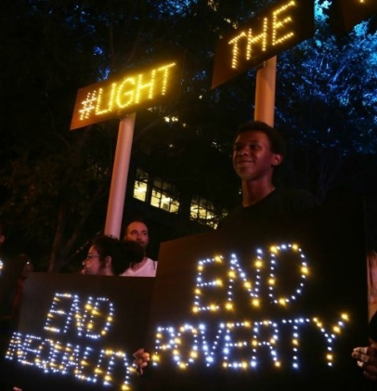
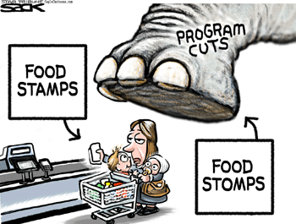
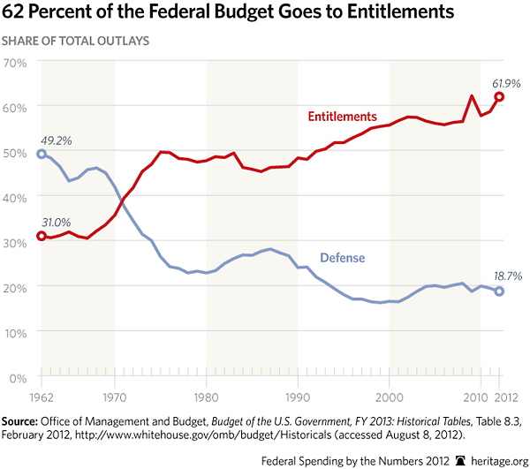
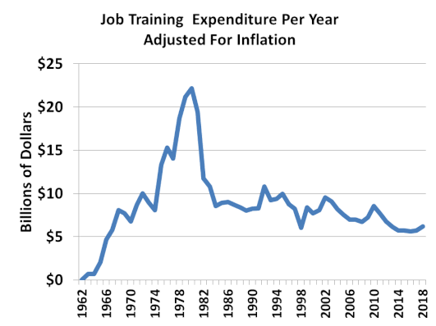
2. Lower Entitlement Spending
Impacted Poorest people big time
Food stamps, welfare, job training
Didn’t touch Middle Class stuff
Social Security, Medicare, military pensions

Slide 7
3. Fewer Gov Regulations
Costs Less Money (less enforcement needed)
People, Banks, and Businesses more free to do what they want
- positives = No fines, Less taxes, Lower prices, More money to spend
- negatives = Could cause pollution, safety issues, personal bankruptcies

Slide 8
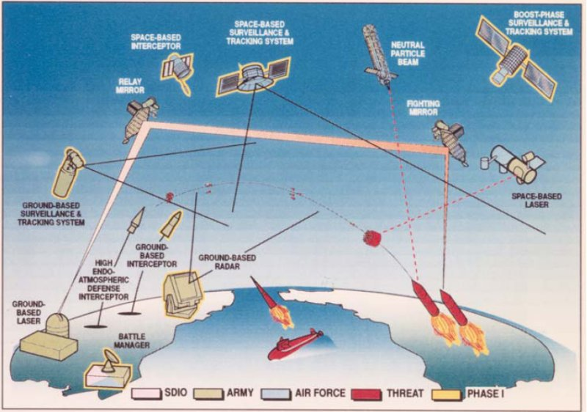
4. Increasing Spending on National Defense
Reagan Doubled This!
Many High Tech Programs
Most Famous = Strategic Defense Initiative (SDI)
Better known as Star Wars
Missile Defense System
Estimated to Cost Trillions of Dollars if Completed
No Guarantee it would work
Eventually scaled down a lot!
Succeeded in scaring Soviet Union

Slide 9
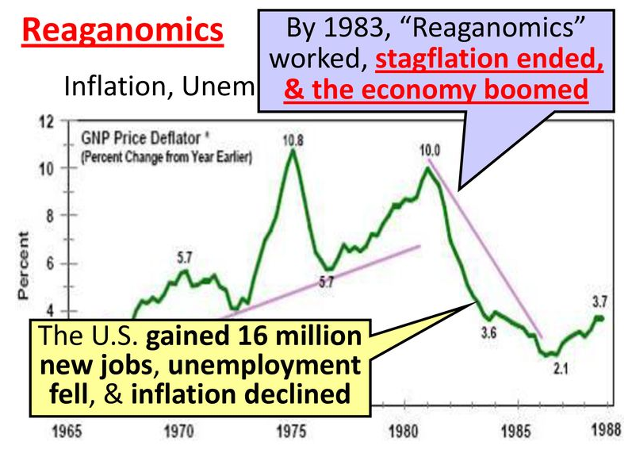
Did Reaganomics work?
YES | NO
Economy improved considerably and people were happy Lower unemployment Lower interest rates for loans Lower taxes for everyone Booming stock market mostly One Hiccup = 1987 Crash (Quick recovery) | Rich got richer and poor got poorer Business owners and Rich people didn’t always do what they were supposed to with tax cuts (see slide 5) Padded their pockets with $ instead Poor really impacted by cuts in entitlement programs National Debt doubled during his 1st term as President Not enough tax $ collected to pay for existing programs

Slide 10
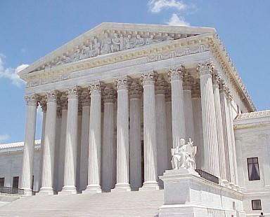
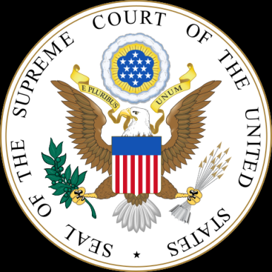
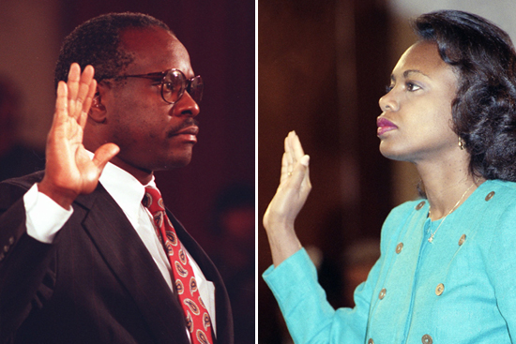
Supreme Court Shift in 1980’s
5 Conservative Justices appointed by Reagan and Bush
1st female ever (Sandra Day O’Connor)
Court begins to interpret laws differently
Less affirmative action, less legal abortion, etc…
Clarence Thomas and Anita Hill

Slide 11
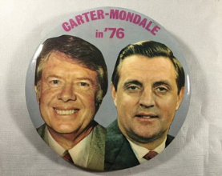
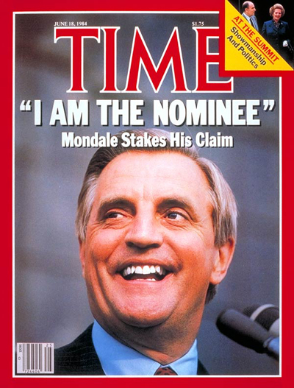
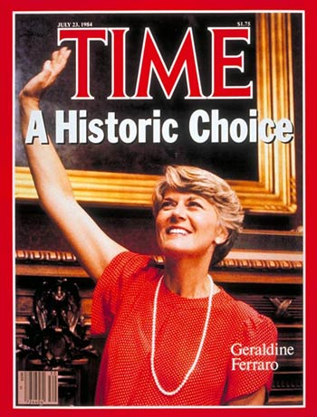
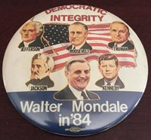
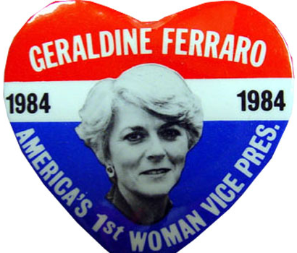
1984 Election - DEmoCRAT Candidate
Walter Mondale
Senator from Minnesota
Vice Pres under Jimmy Carter
Mostly bad memories for country
His running mate was Geraldine Ferraro
1st Female ever on a Presidential Ticket

Slide 12
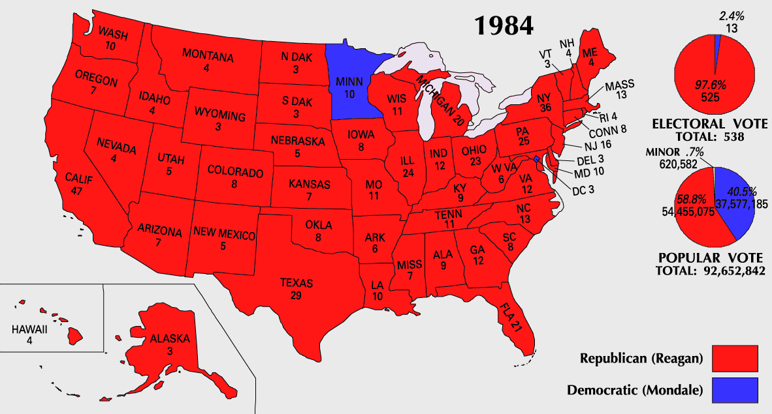
1984 Election – Republican Candidate
Ronald Reagan with Bush as VP again
Very popular
They win easy! 48 states! Mandate!

Slide 13
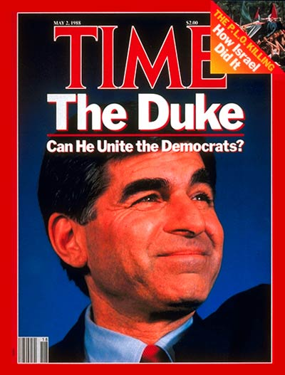
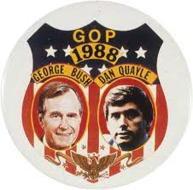
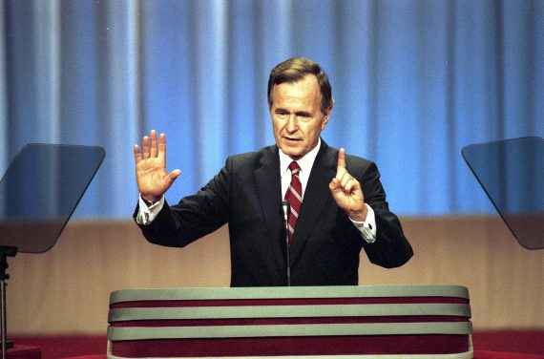
1988 ELECTION
Republican Candidate = George Bush Sr.
WWII hero, House of Rep from Texas, Head of CIA
Reagan can’t run again. Still very popular
His Vice Pres is like voting for Reagan again
Democrat Candidate = Michael Dukakis
Governor of Massachusetts
Not very well known outside of Northern U.S.

Slide 14
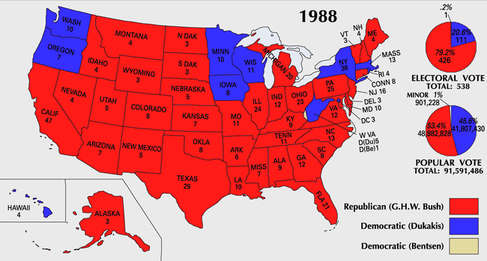
1988 Election Results
Bush Wins easy. (not as big as Reagan… but close)
Country still happy with improvement during Reagan’s 8 years as President

