Slide 1
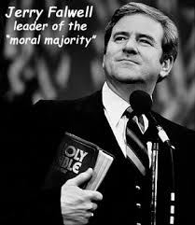
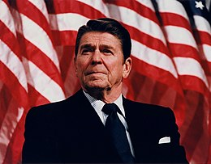
Chapter 25 Section 1 The Conservative Movement

Slide 2
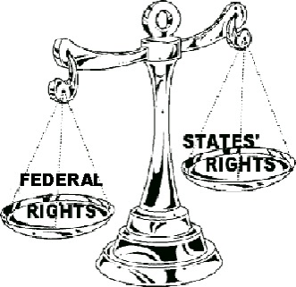
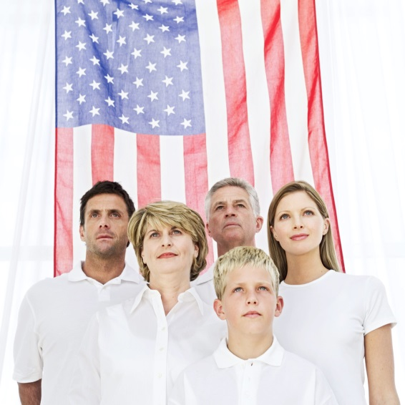
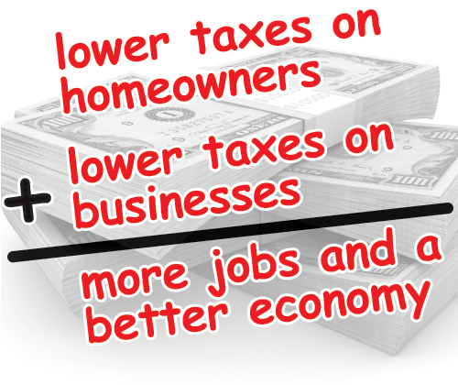
4 goals for Conservatives in the 1980s
1. Less Federal Govt. interference in people’s lives
More freedom for state govts, businesses, and people
Reduce entitlement programs (food stamps, welfare)
2. Promote Family Values and Patriotic Ideals
3. Strengthen National Defense
4. Lower Taxes for people and businesses

Slide 3
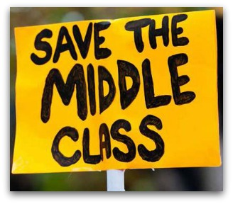
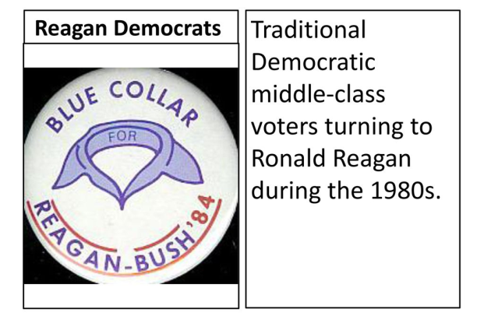
Who was included in the Conservative Coalition?
Business Leaders
Middle Class Voters
Christian Groups
Democrats that didn’t identify with their party anymore

Slide 4
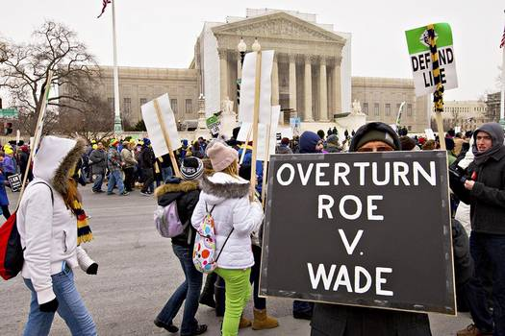
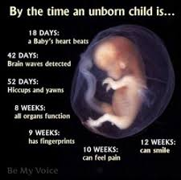
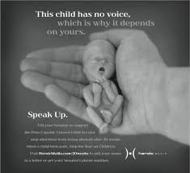
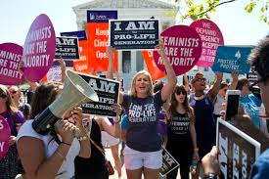
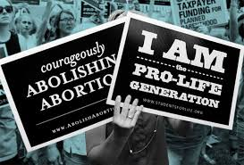
Issues that Conservatives Agree On
1. Opposing Abortion (overturning Roe v. Wade)

Slide 5
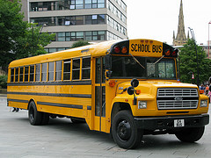
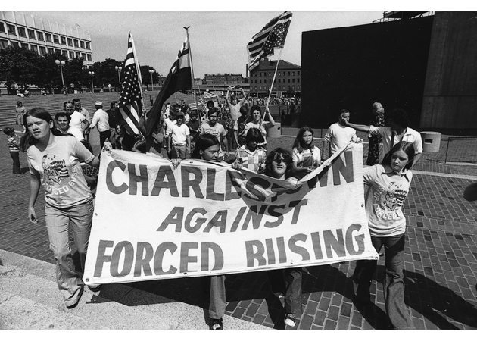
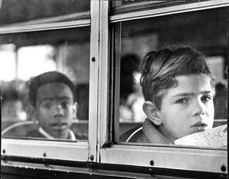
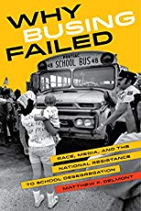
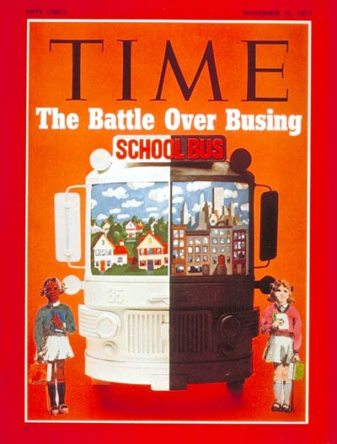
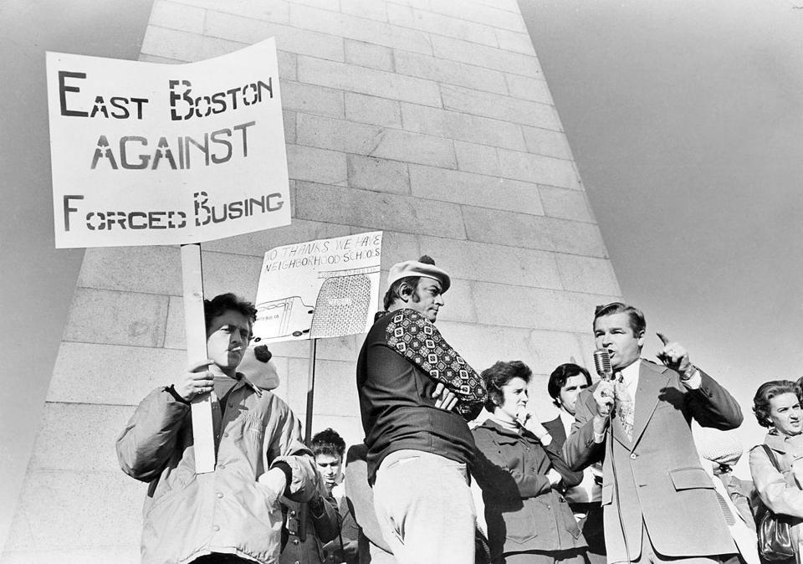
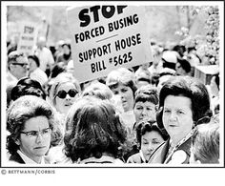
2. Ending Busing Solely to achieve integration in schools

Slide 6
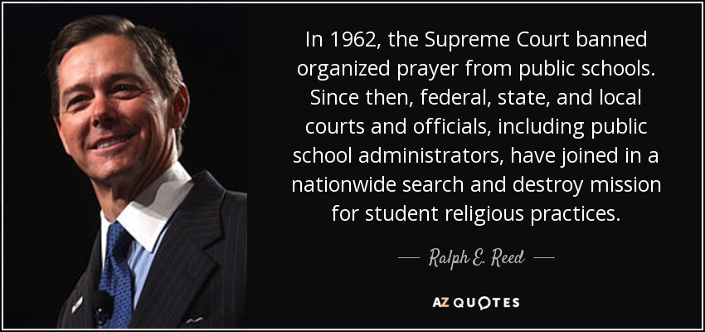
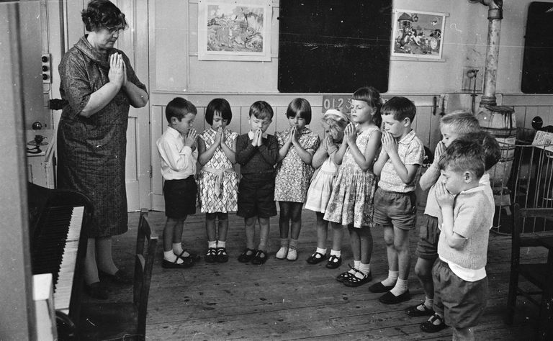
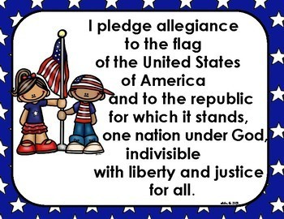
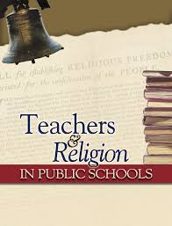
3. Allowing organized prayer in public schools

Slide 7
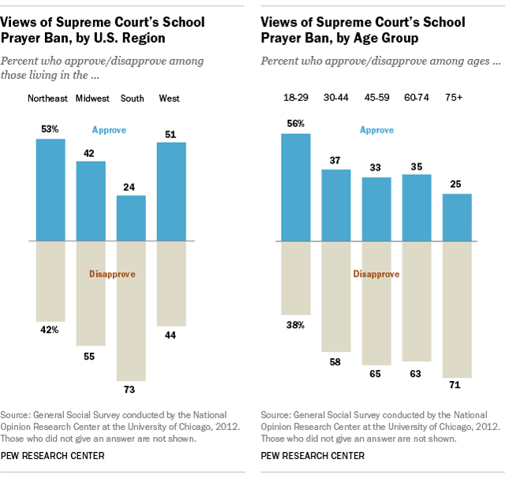
Views on Prayer in Public School 50 years after its banned (2012)

Slide 8
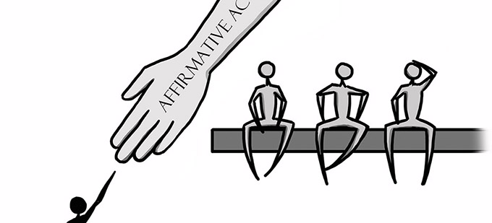
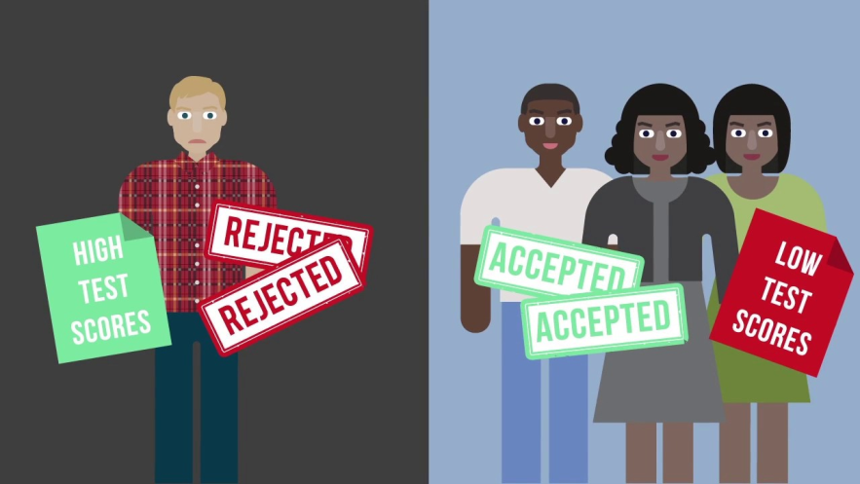
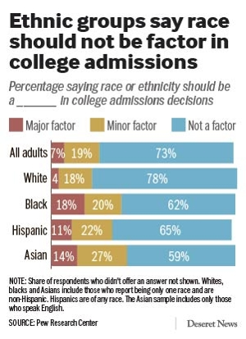
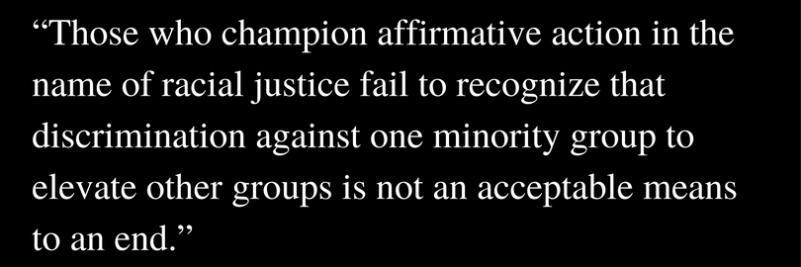
4. Ending Affirmative Action Programs
Many believed they involved reverse discrimination

Slide 9
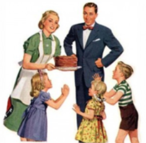
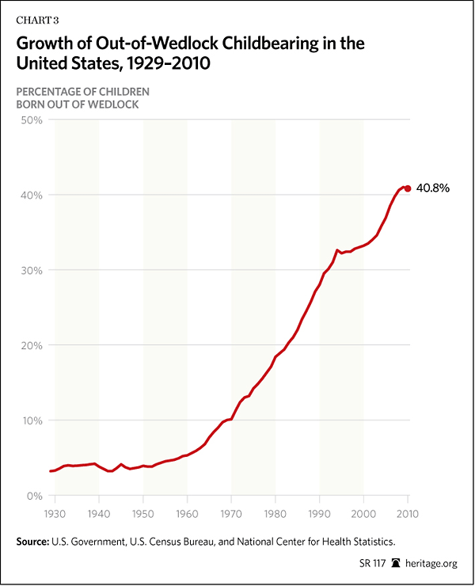
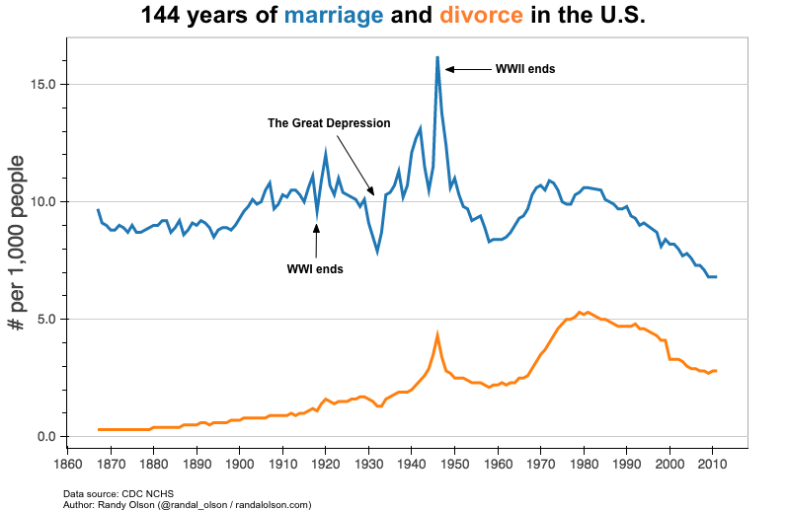
5. Bringing back traditional family and patriotic values
Discourage divorce
Discourage out of wedlock births
Be Proud to be Christian and American
Fly the Flag, Buy American Products, etc…

Slide 10
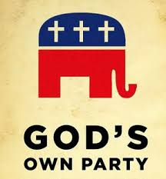
2 Major Conservative Groups began in the 1970’s and Became Popular in the 1980’s

Slide 11
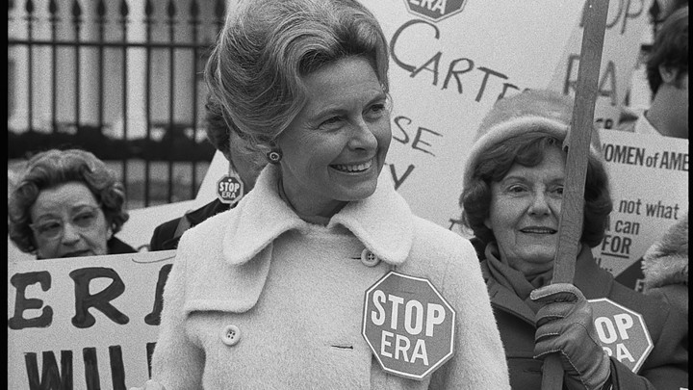
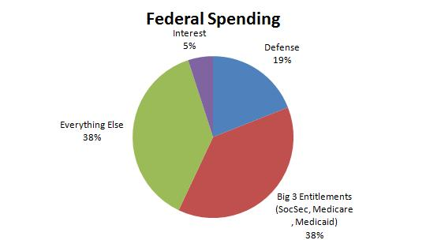
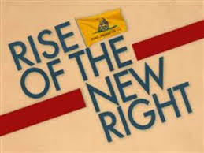
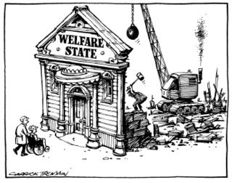
1. The New Right
Vocal leader = Phyllis Schlafly
Formed to oppose liberal changes (ERA, Abortion, Busing, Prayer, Aff. Action)
Less Entitlement Programs (tax $$$ to help different groups)

Slide 12
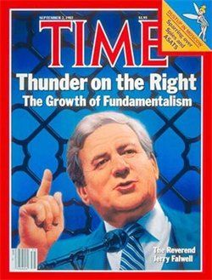
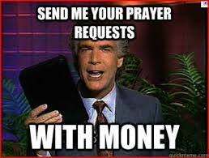
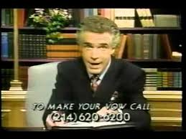
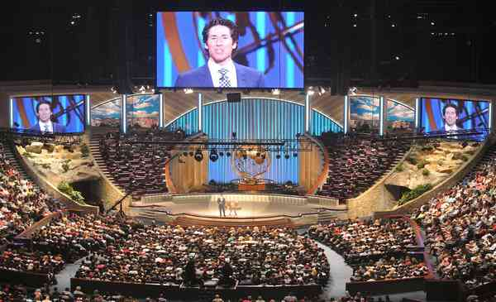
2. The Moral Majority
Vocal leader = Jerry Falwell (believed Bible as 100% truth)
Formed to promote Christian ideals and values
Raised a lot of $ to support politicians with the same beliefs through televangelism (explain)

Slide 13
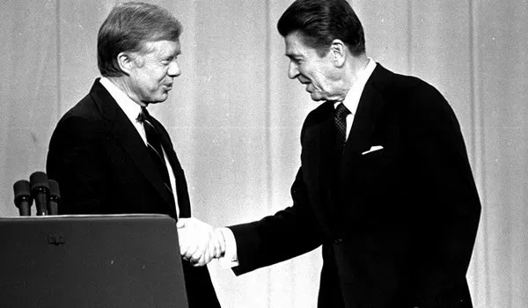
The 1980 Election

Slide 14
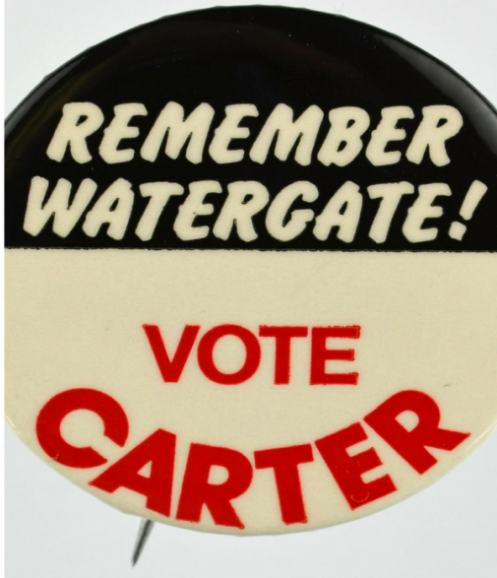
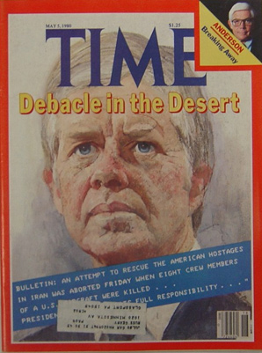
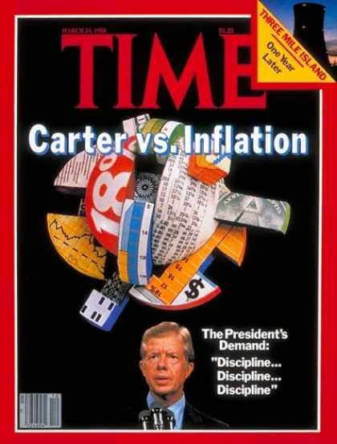
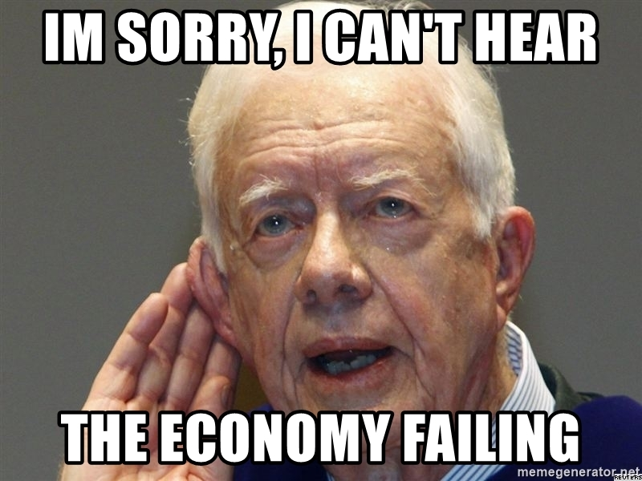
JIMMY CARTER
Democrat
Unpopular by this time
lousy economy, Iran hostages

Slide 15
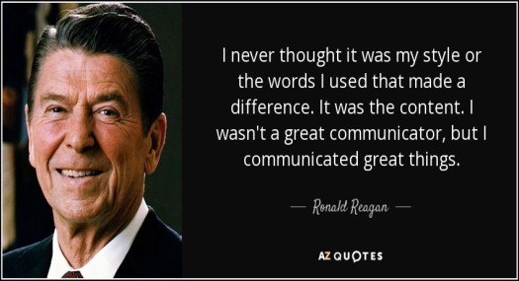
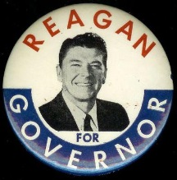
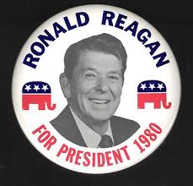
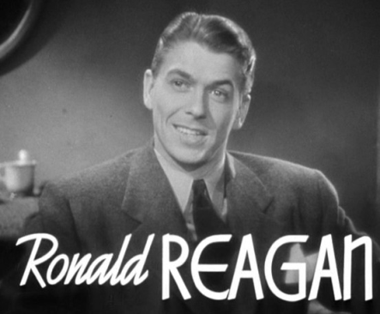
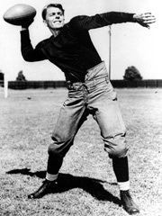
Ronald Reagan
Was a movie actor for 25 years (late 1930s to early 1960s)
Good public speaker (Nickname = Great Communicator)
Relaxed, Used Humor, Spoke in simple terms to people
Governor of California for 8 years
Lost Rep. Nomination to Ford in 1976.
Big believer in conservative policy (lower taxes, stronger military, less nat gov overall)

Slide 16
1980 Election Results
Reagan wins the election in a landslide
Won 44 of 50 states
Senate also became mostly Republican
Has a clear MANDATE (REMEMBER!)

